Slide 1



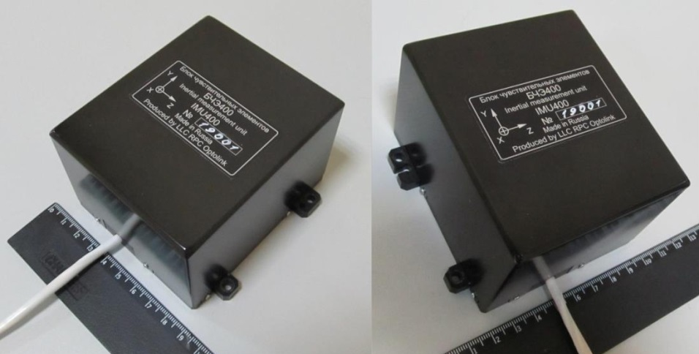




COMPACT NEAR-NAVIGATION-GRADE IFOG
INERTIAL MEASUREMENT UNIT IMU400
Yu.N. Korkishko, V.A. Fedorov, S.V. Prilutskiy, D.V. Obuhovich, I.V. Fedorov
RPC LLC, Moscow, Russia
Fiber Optical Solution, Riga, Latvia
Outline:
Optolink’s production capacities & premises
IMU400 c-SWaP & mechanical properties; accuracy & specs
MEMS accelerometers SF non-linearity & delay evaluation
IMU postprocessing results: gyrocompassing & static; track navigation
Conclusion

Slide 2

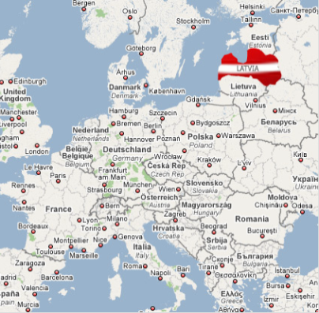
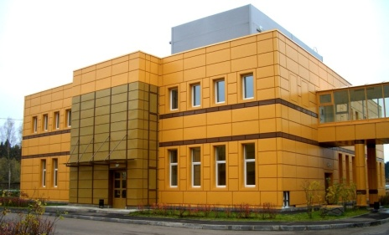
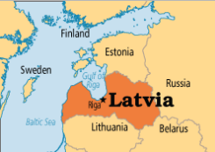
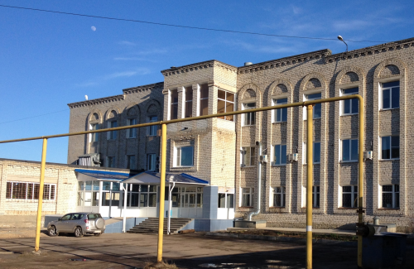
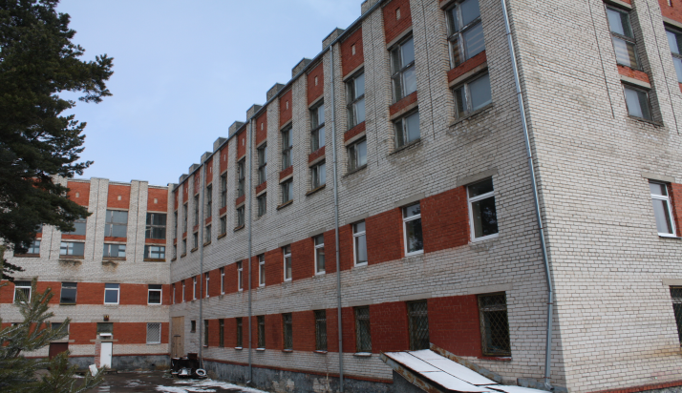
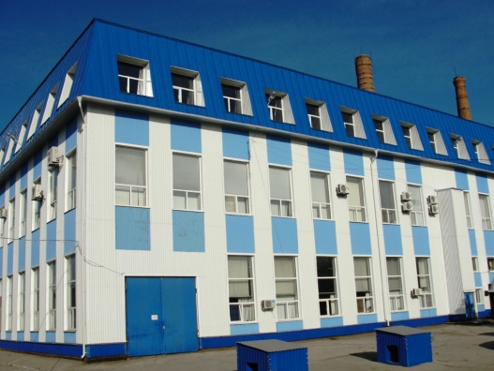
RPC LLC, Moscow, Russia
Fiber Optical Solution, Riga, Latvia
1. Optolink’s production capacities & premises
Headquarters
Moscow, Zelenograd
Development and production of integrated optical circuits on LiNbO₃, fiber-optic sensors and inertial navigation systems.
Arzamas branch
Production of special optical fibers (PM, spun, etc.) and components.
Riga, Podraga 2
Saratov branch
Development and production of fiber-optic gyroscopes and sensors
2
Riga, iela Plata 12B

Slide 3


RPC LLC, Moscow, Russia
Fiber Optical Solution, Riga, Latvia
2a. IMU400 c-SWaP & mechanical properties
80×95×62 mm, 0.7 kg, 0.5 l, ≤7 W
3

Slide 4
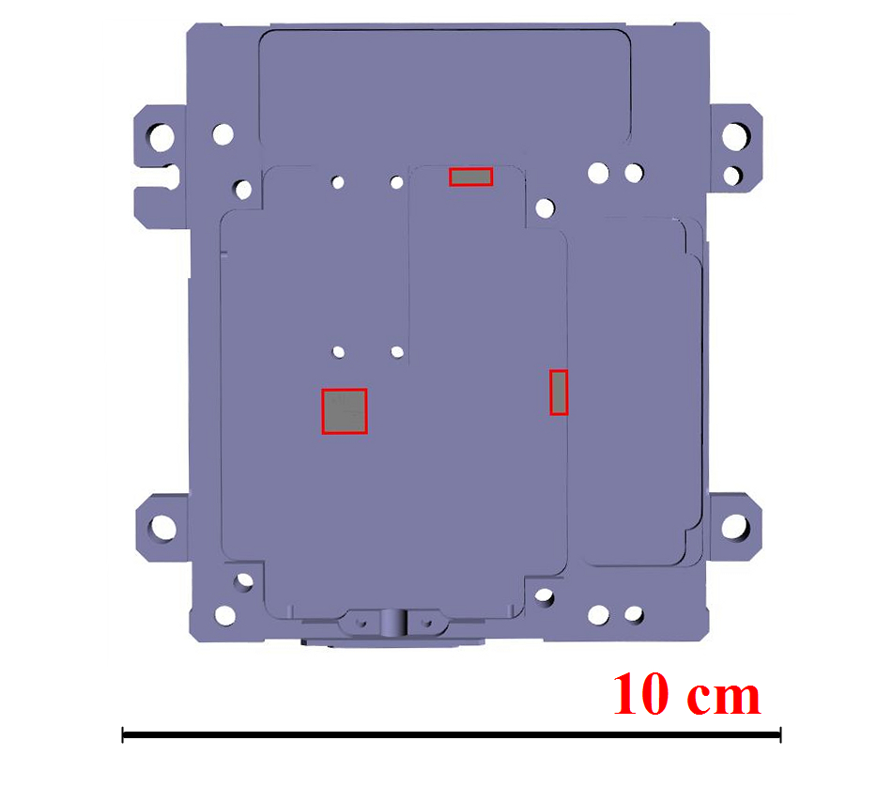

RPC LLC, Moscow, Russia
Fiber Optical Solution, Riga, Latvia
2a. IMU400 c-SWaP & mechanical properties
Spatial displacement of 3 physical MEMS-accelerometer triads inside the IMU400
4

Slide 5
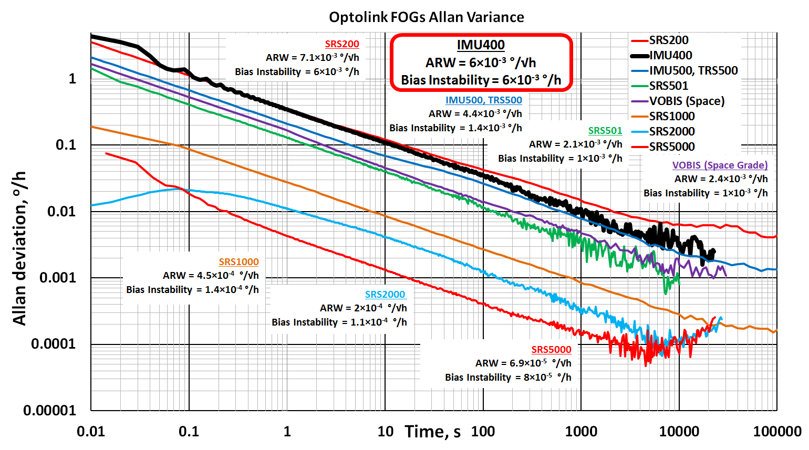
RPC LLC, Moscow, Russia
Fiber Optical Solution, Riga, Latvia
2b. Sensors accuracy and specs
IMU400 Allan Variance plot in Optolink’s FOG family
5

Slide 6
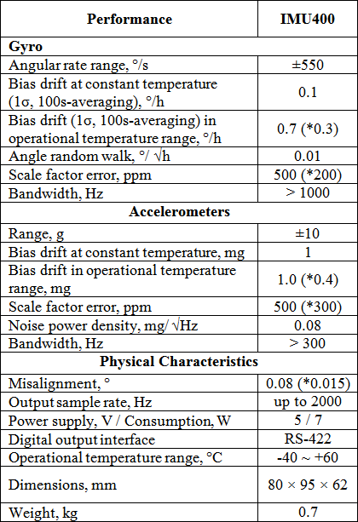
RPC LLC, Moscow, Russia
Fiber Optical Solution, Riga, Latvia
2b. Sensors accuracy and specs
*precise calibration (optional)
6

Slide 7
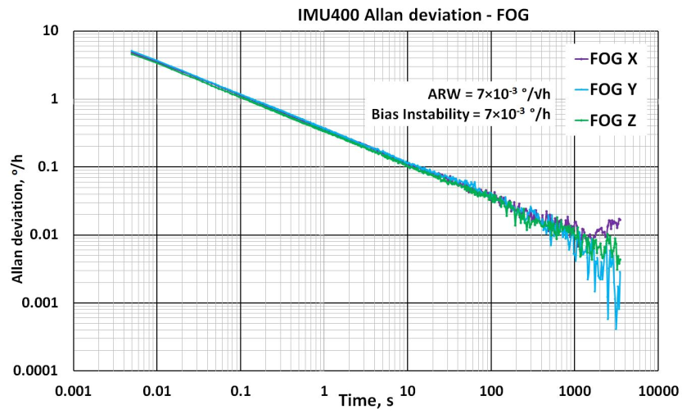

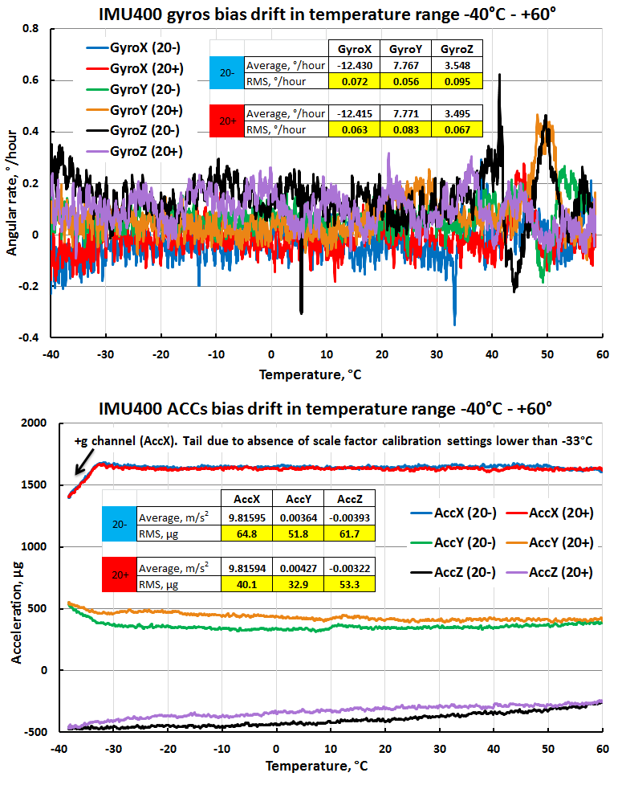
RPC LLC, Moscow, Russia
Fiber Optical Solution, Riga, Latvia
2b. Sensors accuracy and specs
IMU400 FOG and ACC channels Allan variance plot
IMU400 Gyroscopes & Accelerometers bias plots in temperature range
7

Slide 8
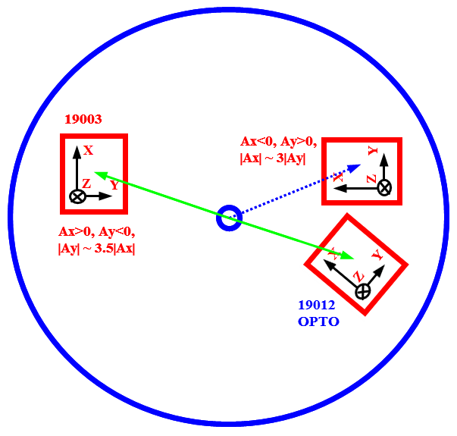
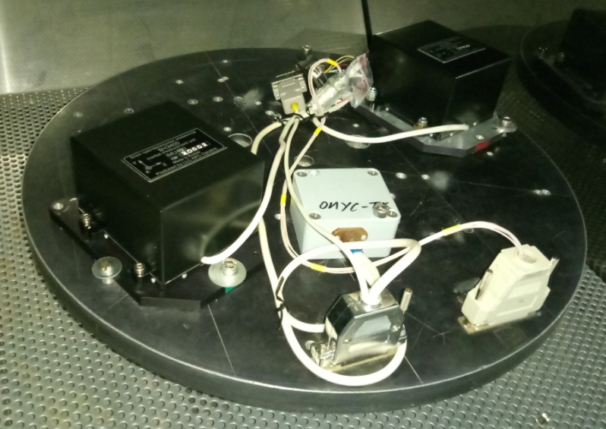
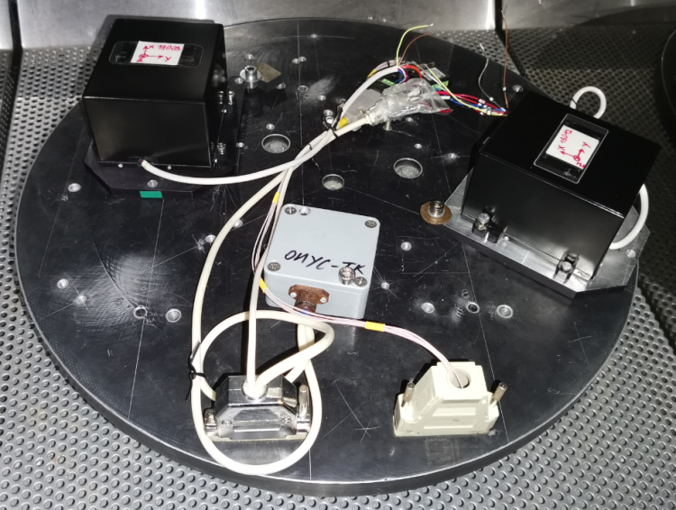
RPC LLC, Moscow, Russia
Fiber Optical Solution, Riga, Latvia
3a. MEMS accelerometers SF non-linearity
Test setup design:
Precise rate table with multiple mounting holes (optolink self made)
2 IMUs in tests, balanced wrt center. Eff. radii ~10-13cm. Rotation rate up to 2000°/s.
IMU positioning not only with definite (a) axes along centipetal, but with random (b) acceleration distribution over channels – for even estimation of 3-axis MEMS sensors
(a) IMUs with definite (-Z) axes along centipetal
(b) random acceleration distribution over channels
8

Slide 9
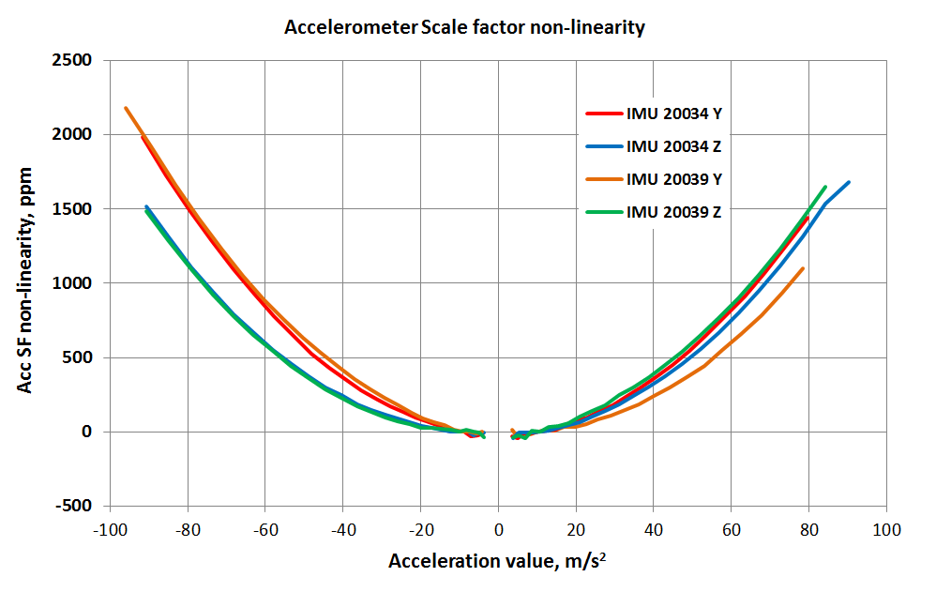
RPC LLC, Moscow, Russia
Fiber Optical Solution, Riga, Latvia
3a. MEMS accelerometers SF non-linearity
Results - for random IMU positioning (b):
Accelerometers have predictable non-linearity pattern which can be compensated, if needed. May be asymmetric.
Errors scale is ~2000ppm non-linearity error at ±10g.
However, at ±2g <100ppm. Therefore, for the civic/marine range of applications, no need to compensate.
9

Slide 10
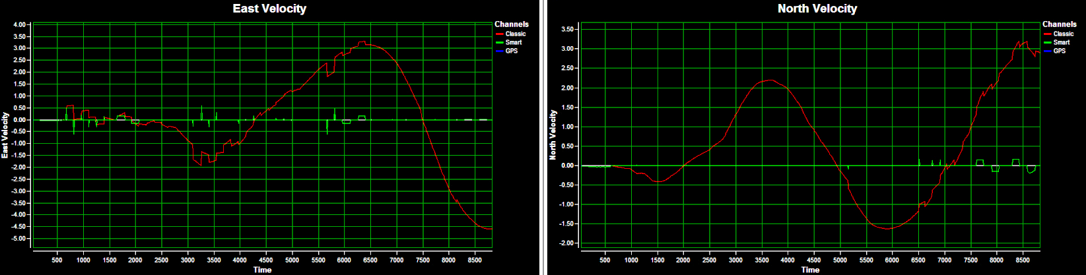
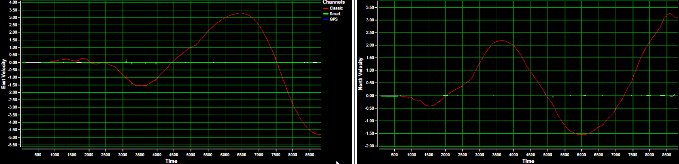
RPC LLC, Moscow, Russia
Fiber Optical Solution, Riga, Latvia
3b. MEMS accelerometers delay
Initial IMU400 design showed measurement delay between Gyro/Acc triads as whole (upper image, 2019-year IMU400 calibration launch, inertial velocities).
In 2020, we improved schematics to get rid of the delay and thus making inertial behavior better (lower image, removing delays in post-processing).
10

Slide 11
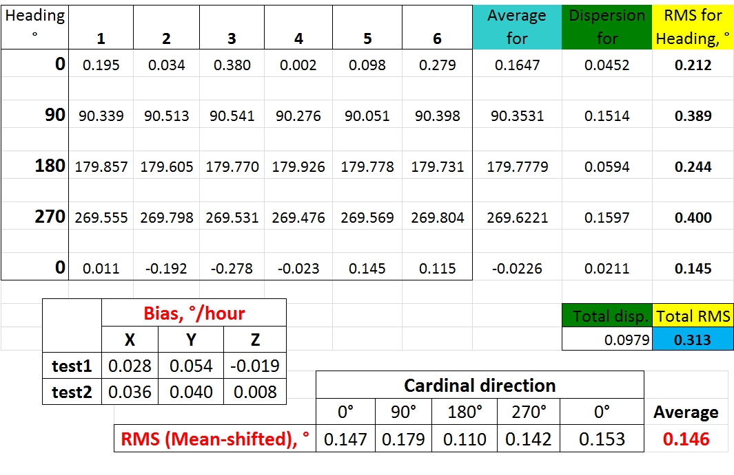
RPC LLC, Moscow, Russia
Fiber Optical Solution, Riga, Latvia
4a. Test results, gyrocompassing
At 56° N Lat.
11

Slide 12
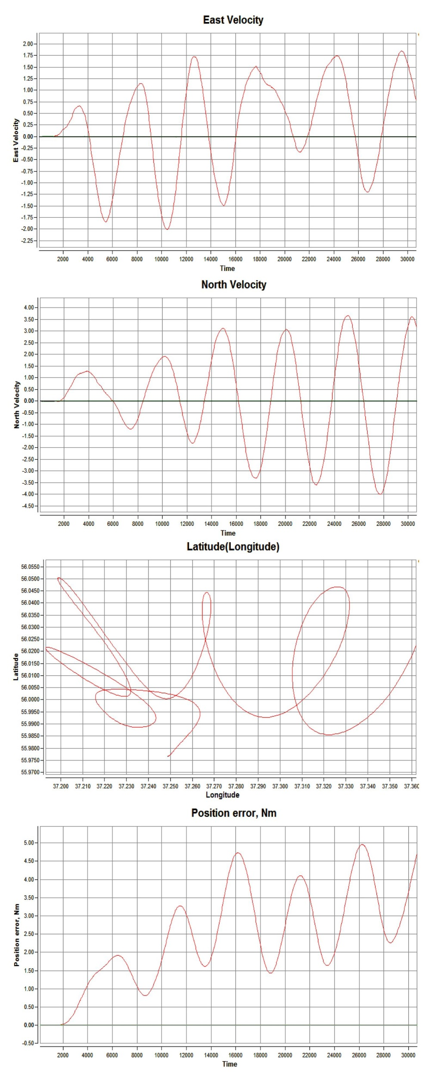
RPC LLC, Moscow, Russia
Fiber Optical Solution, Riga, Latvia
4a. Test results, static – 5Nm at 8h
12

Slide 13
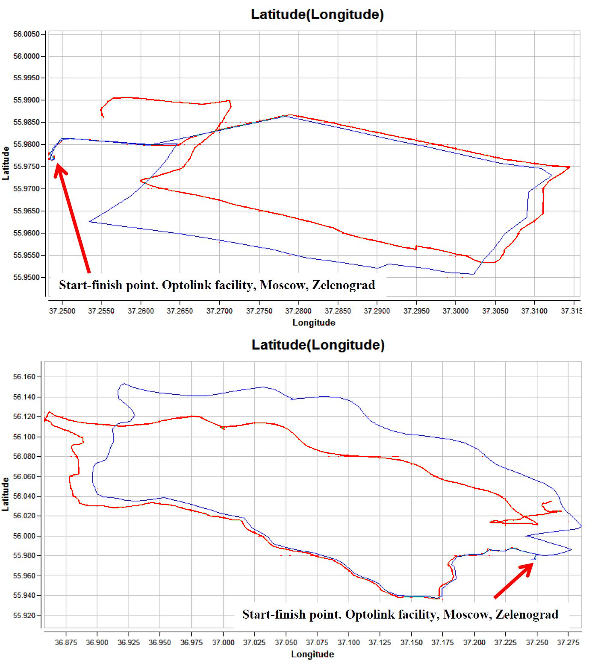
RPC LLC, Moscow, Russia
Fiber Optical Solution, Riga, Latvia
4b. Test results – track navigation 1
IMU400 navigation performance in compensated inertial mode (ZUPT) :
~30 km (~1km CPE error)
13

Slide 14
RPC LLC, Moscow, Russia
Fiber Optical Solution, Riga, Latvia
4b. Test results – track navigation 2
IMU400 navigation performance in compensated inertial mode (ZUPT) :
~110 km (~10km CPE error)
14

Slide 15
RPC LLC, Moscow, Russia
Fiber Optical Solution, Riga, Latvia
5. Conclusion
Demonstrated performance allows to assess IMU400 as navigation or near-navigation grade IMU with unique combination of performance / cost / SWaP characteristics.
> 100 units already delivered to customers (2019.06 till now)

