Slide 1




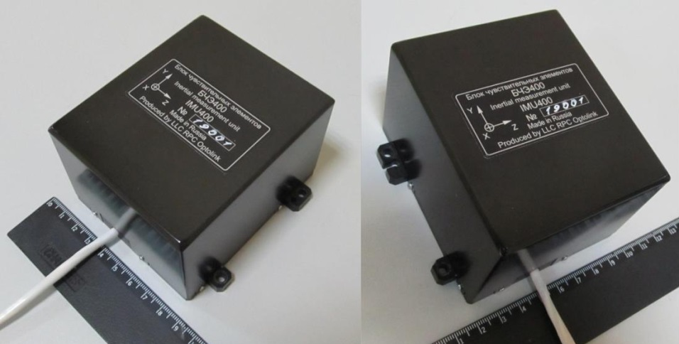



Ultra-compact navigation-grade Inertial Measurement Unit IMU400
Yu.N. Korkishko, V.A. Fedorov, V.E. Prilutskiy, V.G. Ponomarev, et. al.
RPC LLC, Moscow, Russia
Fiber Optical Solution, Riga, Latvia
Outline:
Optolink’s production capacities & premises
IMU400 c-SWaP & mechanical properties
Sensors accuracy and specs
Test results - gyrocompassing & static
Test results – navigation
Conclusion

Slide 2
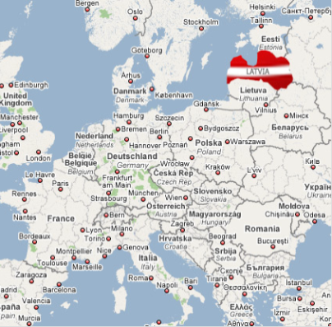
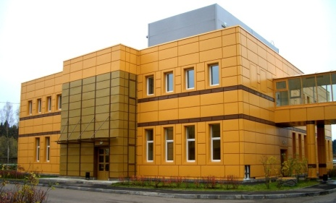
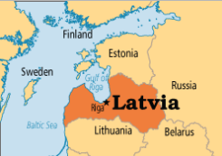
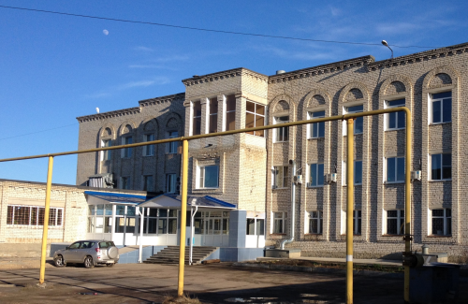
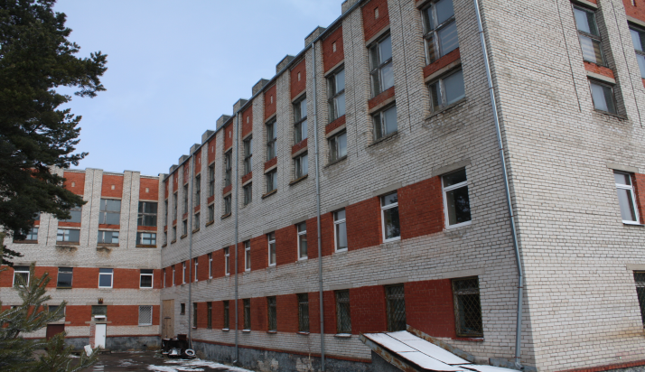
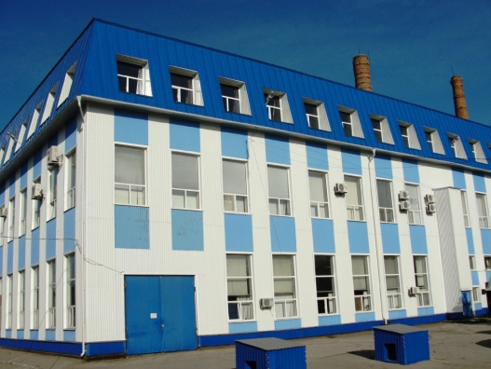
Ultra-compact navigation-grade Inertial Measurement Unit IMU400
Yu.N. Korkishko, V.A. Fedorov, V.E. Prilutskiy, V.G. Ponomarev, et. al.
RPC LLC, Moscow, Russia
Fiber Optical Solution, Riga, Latvia
1. Optolink’s production capacities & premises
Headquarters
Moscow, Zelenograd
Development and production of integrated optical circuits on LiNbO₃, fiber-optic sensors and inertial navigation systems.
Arzamas branch
Production of special optical fibers (PM, spun, etc.) and components.
Riga, Podraga 2
Saratov branch
Development and production of fiber-optic gyroscopes and sensors
Riga, iela Plata 12B

Slide 3


Ultra-compact navigation-grade Inertial Measurement Unit IMU400
Yu.N. Korkishko, V.A. Fedorov, V.E. Prilutskiy, V.G. Ponomarev, et. al.
RPC LLC, Moscow, Russia
Fiber Optical Solution, Riga, Latvia
2. IMU400 c-SWaP & mechanical properties
80×95×62 mm, 0.7 kg, 0.5 l, ≤7 W

Slide 4
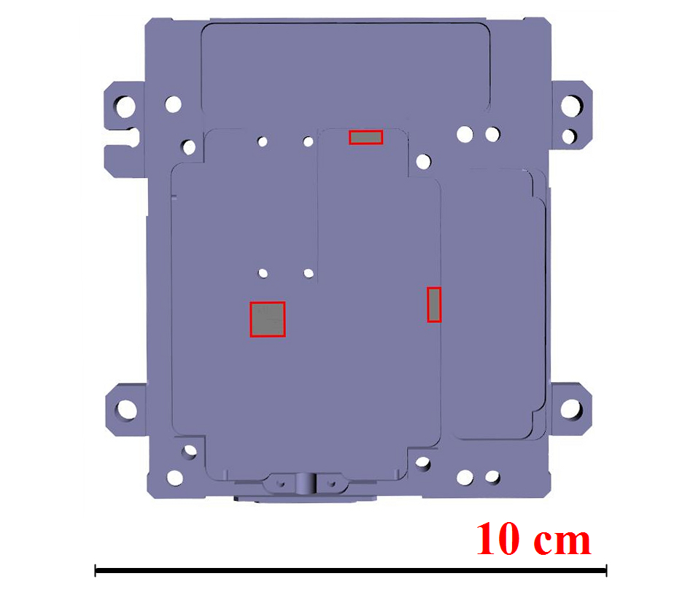

Ultra-compact navigation-grade Inertial Measurement Unit IMU400
Yu.N. Korkishko, V.A. Fedorov, V.E. Prilutskiy, V.G. Ponomarev, et. al.
RPC LLC, Moscow, Russia
Fiber Optical Solution, Riga, Latvia
2. IMU400 c-SWaP & mechanical properties
Spatial displacement of 3 physical MEMS-accelerometer triads inside the IMU400

Slide 5
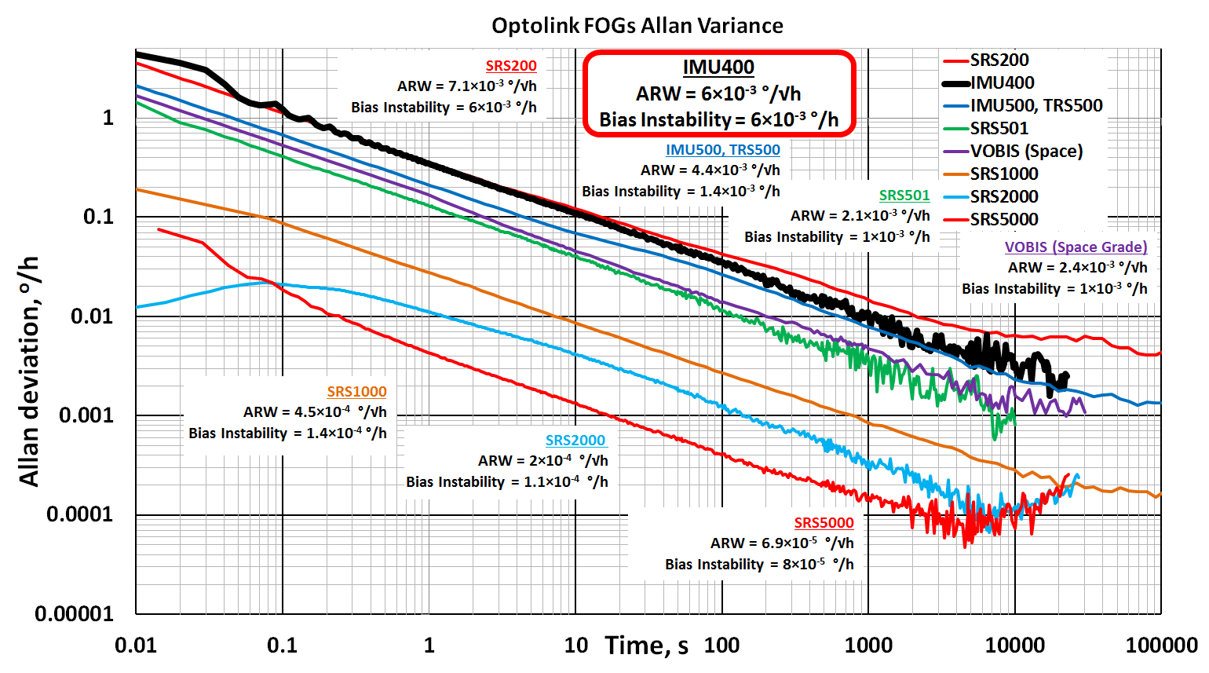
Ultra-compact navigation-grade Inertial Measurement Unit IMU400
Yu.N. Korkishko, V.A. Fedorov, V.E. Prilutskiy, V.G. Ponomarev, et. al.
RPC LLC, Moscow, Russia
3. Sensors accuracy and specs
Fiber Optical Solution, Riga, Latvia
IMU400 Allan Variance plot in Optolink’s FOG family

Slide 6
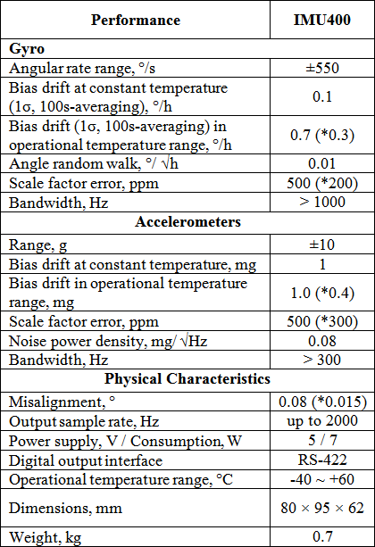
Ultra-compact navigation-grade Inertial Measurement Unit IMU400
Yu.N. Korkishko, V.A. Fedorov, V.E. Prilutskiy, V.G. Ponomarev, et. al.
RPC LLC, Moscow, Russia
3. Sensors accuracy and specs
Fiber Optical Solution, Riga, Latvia

Slide 7
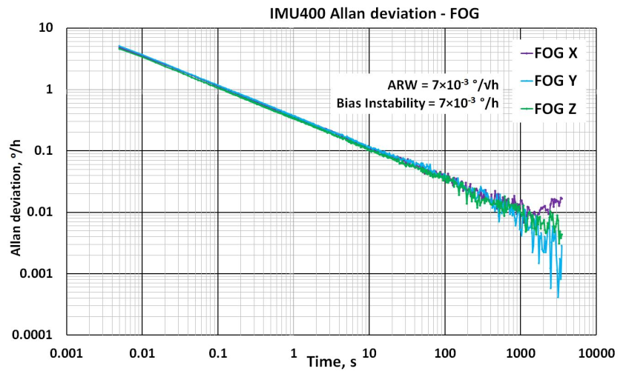

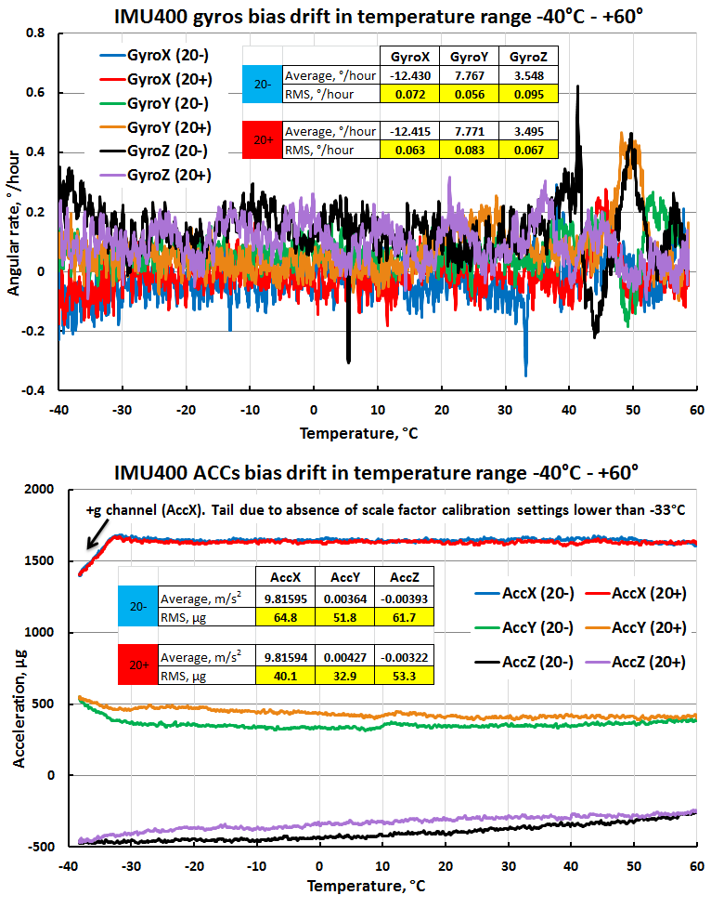
Ultra-compact navigation-grade Inertial Measurement Unit IMU400
Yu.N. Korkishko, V.A. Fedorov, V.E. Prilutskiy, V.G. Ponomarev, et. al.
RPC LLC, Moscow, Russia
3. Sensors accuracy and specs
Fiber Optical Solution, Riga, Latvia
IMU400 FOG and ACC channels Allan variance plot
IMU400 Gyroscopes & Accelerometers bias stability plots in temperature range

Slide 8
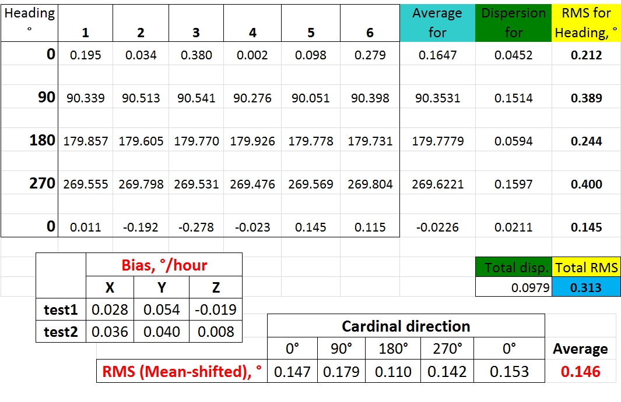
Ultra-compact navigation-grade Inertial Measurement Unit IMU400
Yu.N. Korkishko, V.A. Fedorov, V.E. Prilutskiy, V.G. Ponomarev, et. al.
RPC LLC, Moscow, Russia
Fiber Optical Solution, Riga, Latvia
4. Test results - gyrocompassing
At 56° N Lat.

Slide 9
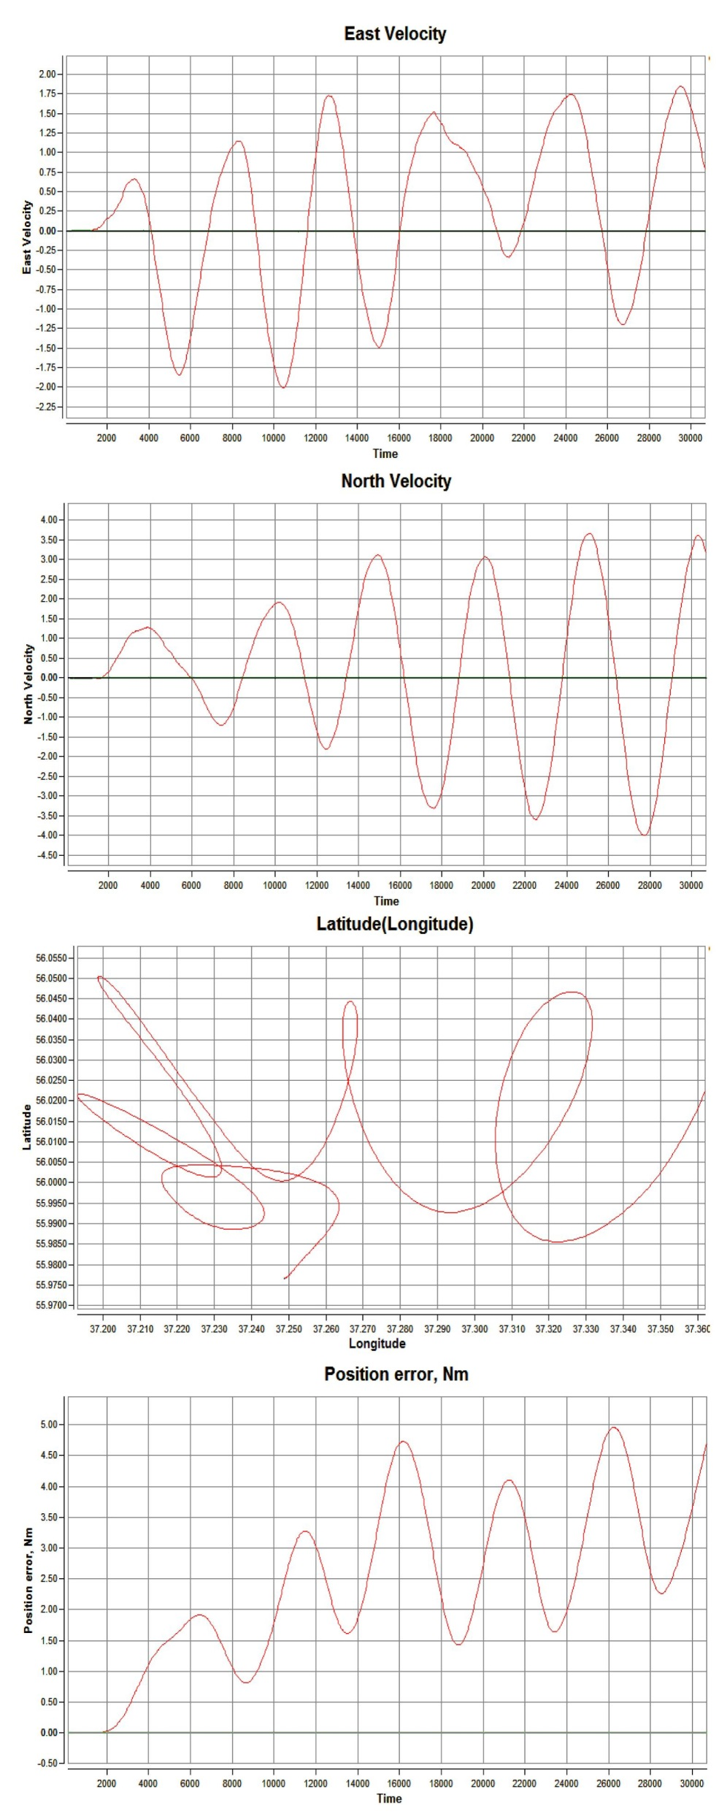
Ultra-compact navigation-grade Inertial Measurement Unit IMU400
Yu.N. Korkishko, V.A. Fedorov, V.E. Prilutskiy, V.G. Ponomarev, et. al.
RPC LLC, Moscow, Russia
Fiber Optical Solution, Riga, Latvia
4. Test results – static – 5Nm at 8h

Slide 10
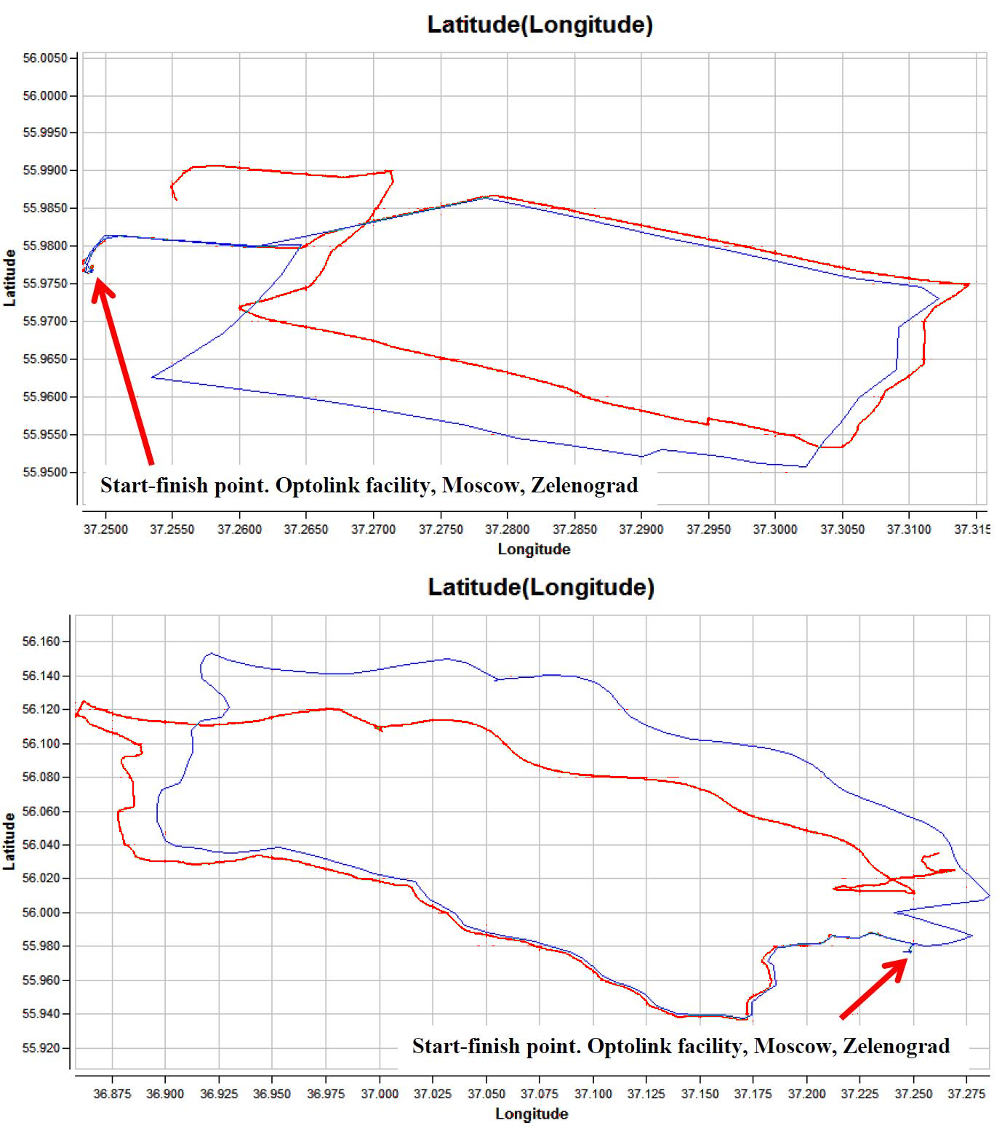
Ultra-compact navigation-grade Inertial Measurement Unit IMU400
Yu.N. Korkishko, V.A. Fedorov, V.E. Prilutskiy, V.G. Ponomarev, et. al.
RPC LLC, Moscow, Russia
Fiber Optical Solution, Riga, Latvia
5. Test results - navigation
IMU400 navigation performance in compensated inertial mode (ZUPT) :
~30 km (~1km CPE error)

Slide 11
Ultra-compact navigation-grade Inertial Measurement Unit IMU400
Yu.N. Korkishko, V.A. Fedorov, V.E. Prilutskiy, V.G. Ponomarev, et. al.
RPC LLC, Moscow, Russia
Fiber Optical Solution, Riga, Latvia
5. Test results - navigation
IMU400 navigation performance in compensated inertial mode (ZUPT) :
~110 km (~10km CPE error)

Slide 12
Ultra-compact navigation-grade Inertial Measurement Unit IMU400
Yu.N. Korkishko, V.A. Fedorov, V.E. Prilutskiy, V.G. Ponomarev, et. al.
RPC LLC, Moscow, Russia
Fiber Optical Solution, Riga, Latvia
6. Conclusion
Demonstrated performance allows to assess IMU400 as navigation or near-navigation grade IMU with unique combination of performance / cost / SWaP characteristics.

